Slide 1
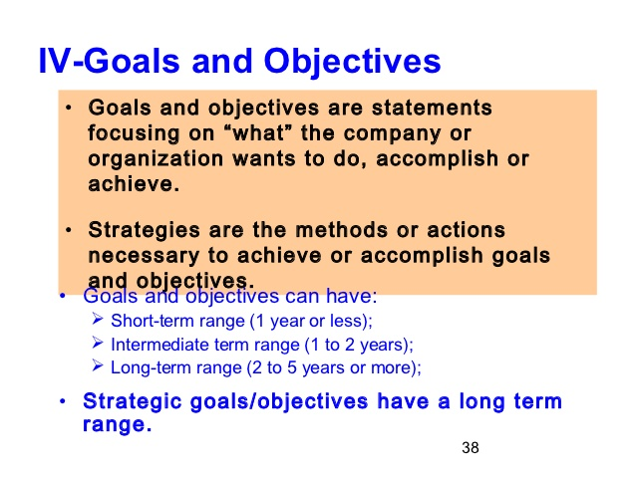

Slide 2
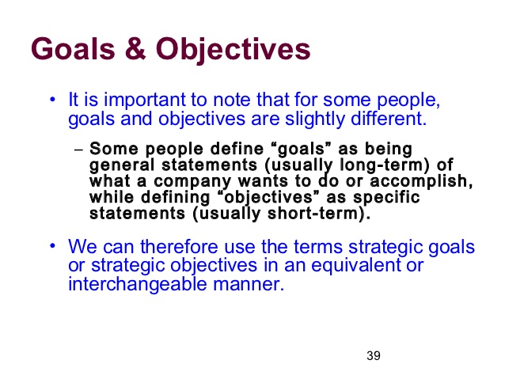

Slide 3
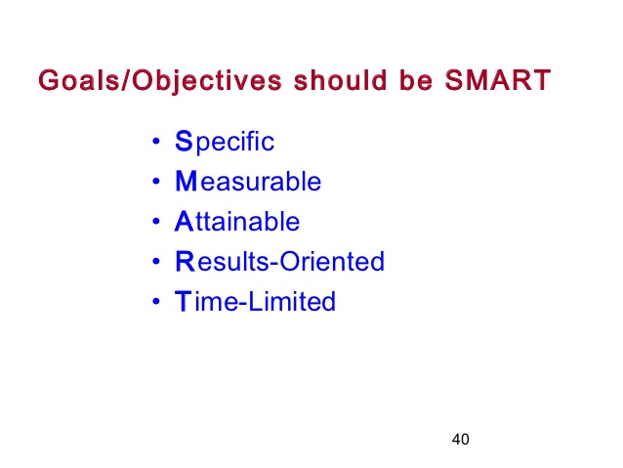

Slide 4
GOALS
Goals are the overall objectives of a department or an organization.
It is defined as what an organization wants to achieve during or by the end of a given period.
The purpose of goals is to give you something that you want to enhance your life in some way, so the most important thing you need to know about goals is that you ought to have some.

Slide 5
Types of Goals
Long Term Goals:
10-year, 5-year and 1-year goals
Short Term Goals:
goals for the next 9 months, 6 months and 3 months
Immediate Goals:
1-30 days from now

Slide 6
5 Qualities of Effective Goals
S.M.A.R.T.
The Goal should be SPECIFIC enough so that we know exactly for what we are striving.
MEASURABLE A goal must be MEASURABLE. It should have concrete facts. You should be able to answer very specifically, when and how you will know you attained your goal.
ACTION ORIENTED, declaring positive activity that will produce results.
RESULTS ORIENTED
TIME-LIMITED

Slide 7
Key Terms in Strategic Management
Objectives
  specific results that an organization seeks to achieve in pursuing its basic mission
  long-term means more than one year
  should be challenging, measurable, consistent, reasonable, and clear
1-<number>
Notes:
Objectives are specific results that an organization seeks to achieve in pursuing its basic mission.
Long-term means more than one year
They should be challenging, measurable, consistent, reasonable, and clear

Slide 8
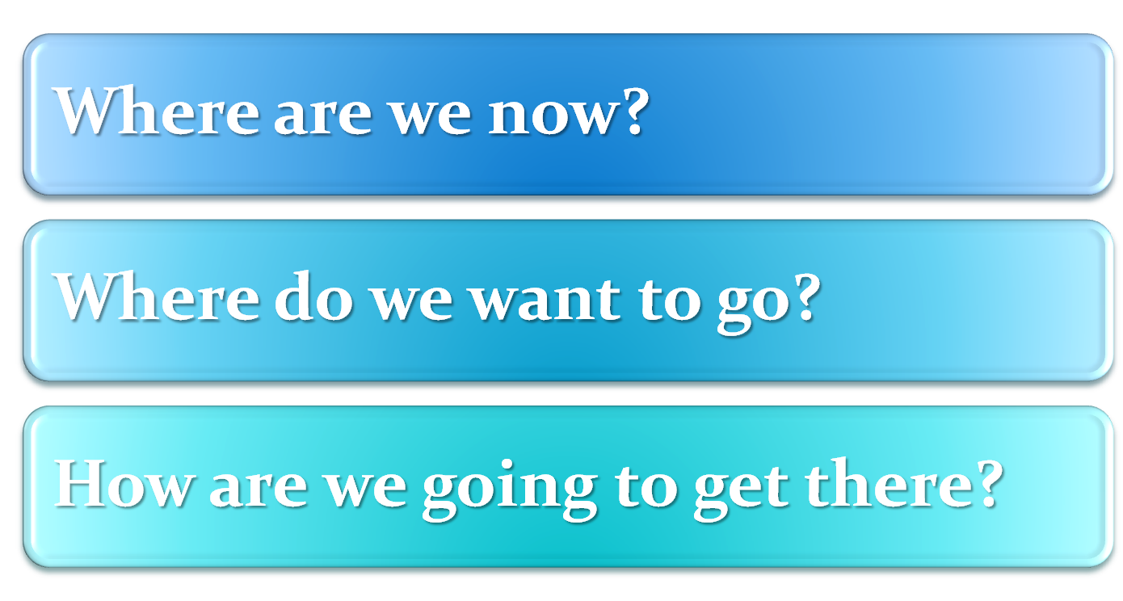
The Strategic-Management Model
1-<number>
Notes:
These are three important questions to answer in developing a strategic plan:
Where are we now?
Where do we want to go?
How are we going to get there?

Slide 9
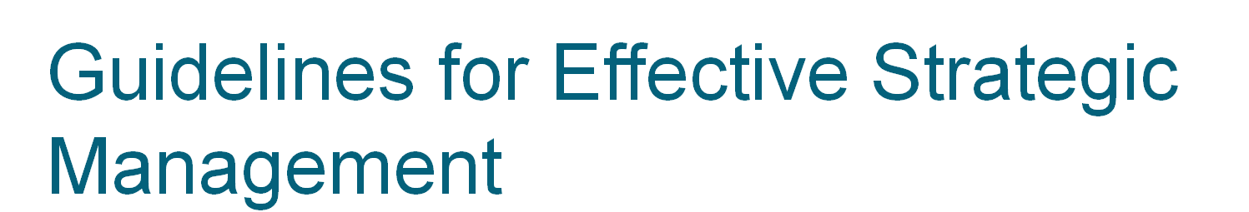
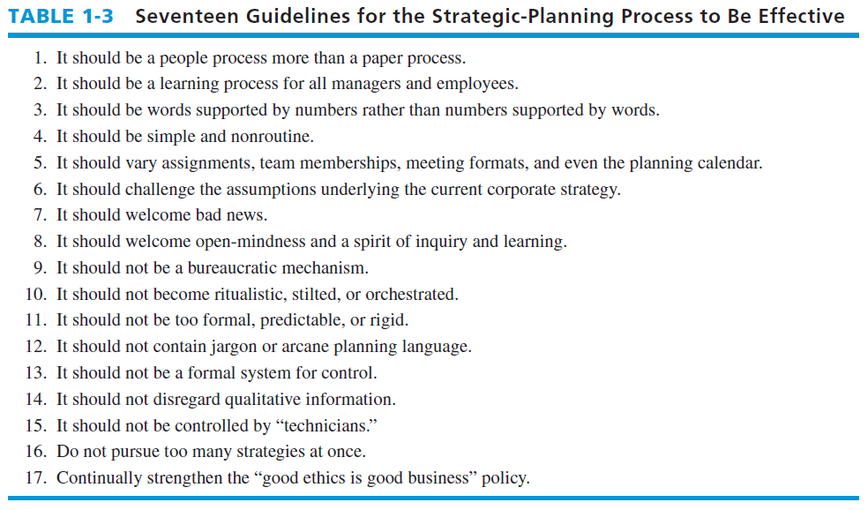
Notes:
Table 1-3
summarizes important guidelines for the strategic-planning process to be effective.

